Slide 1
PE Location
& Procedure Characteristics
Exploratory Data Analysis
Katherine Tu

Slide 2

Presenter Introduction
B.S Mathematics at University of California, Irvine
M.S Analytics at University of Chicago

Slide 3
Agenda
1
2
3
4
5
Dataset
Overview
Data Preprocessing
Outliers
Data Preprocessing
Missing Values
Methodology
Test Results

Slide 4
Dataset Overview
Sample Size
PE Location
Time Characteristics
325 Patients in total
Saddle
Bilateral
Unilateral
Procedure time
Catheter time
Fluoroscopy time

Slide 5
Data Preprocessing
1
Outliers
Found one extreme outlier in catheter time
2
Missing Value
Fill missing value with median or using linear regression

Slide 6
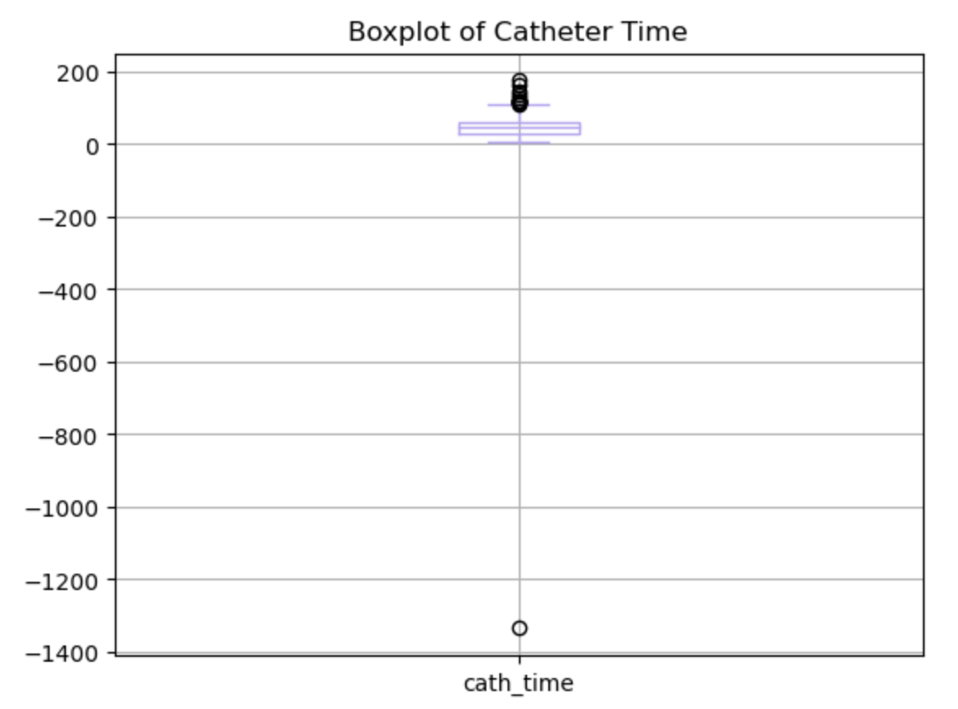
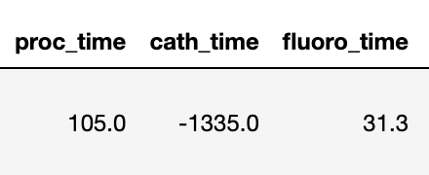
Outliers
Cather time cannot be negative, maybe due to human data entry error
Check whether there are errors in proc_time and fluoro_time for this patient
Treat this outlier as null value and fill it using linear regression to avoid information loss

Slide 7
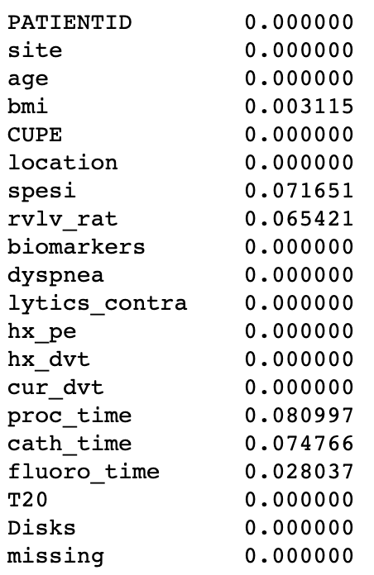
Missing Value
Fill null values to avoid information loss
Fill null values in bmi, spesi, and rvlv_rat columns with median
Fill null values in procedure time, catheter time, and fluoroscopy time columns using linear regression

Slide 8
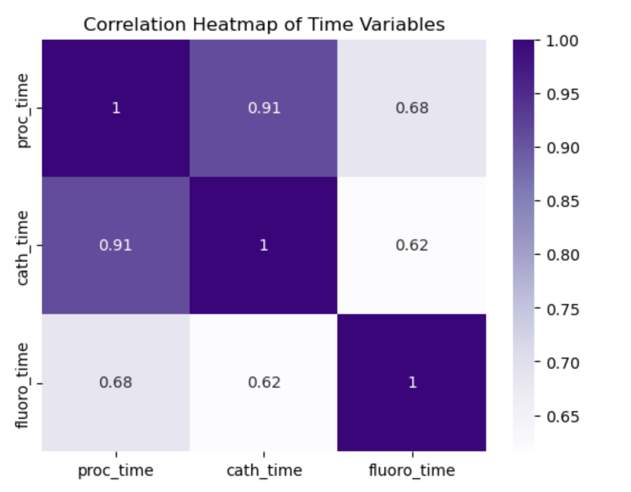
Missing Value
Strong correlation between time variables

Slide 9
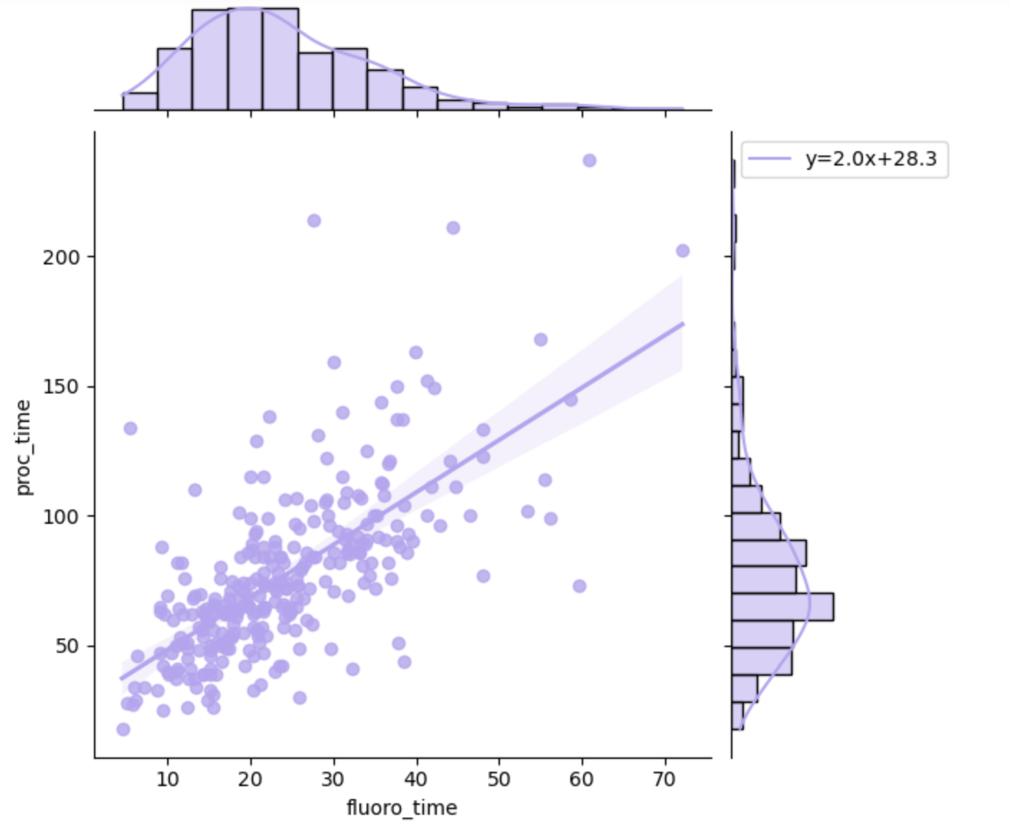
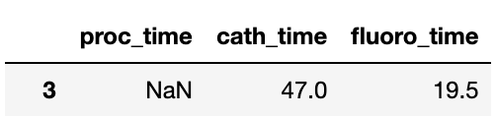
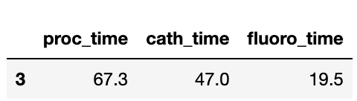
Missing Value — Procedure Time
Linear relationship between procedure time and fluoroscopy time
Use original fluoroscopy time to generate procedure time and fill null values

Slide 10
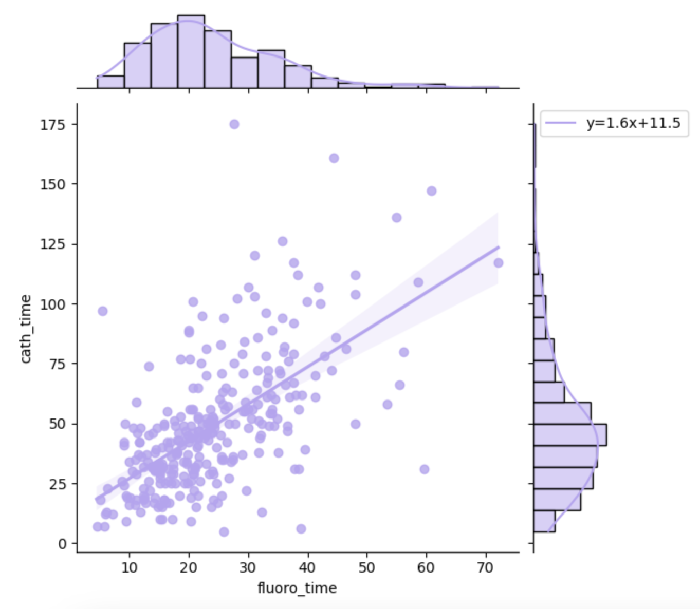
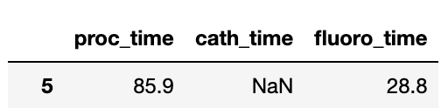
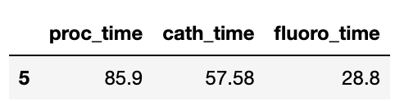
Missing Value — Catheter Time
Linear relationship between catheter time and fluoroscopy time
Use original fluoroscopy time to generate catheter time and fill null values and one outlier

Slide 11
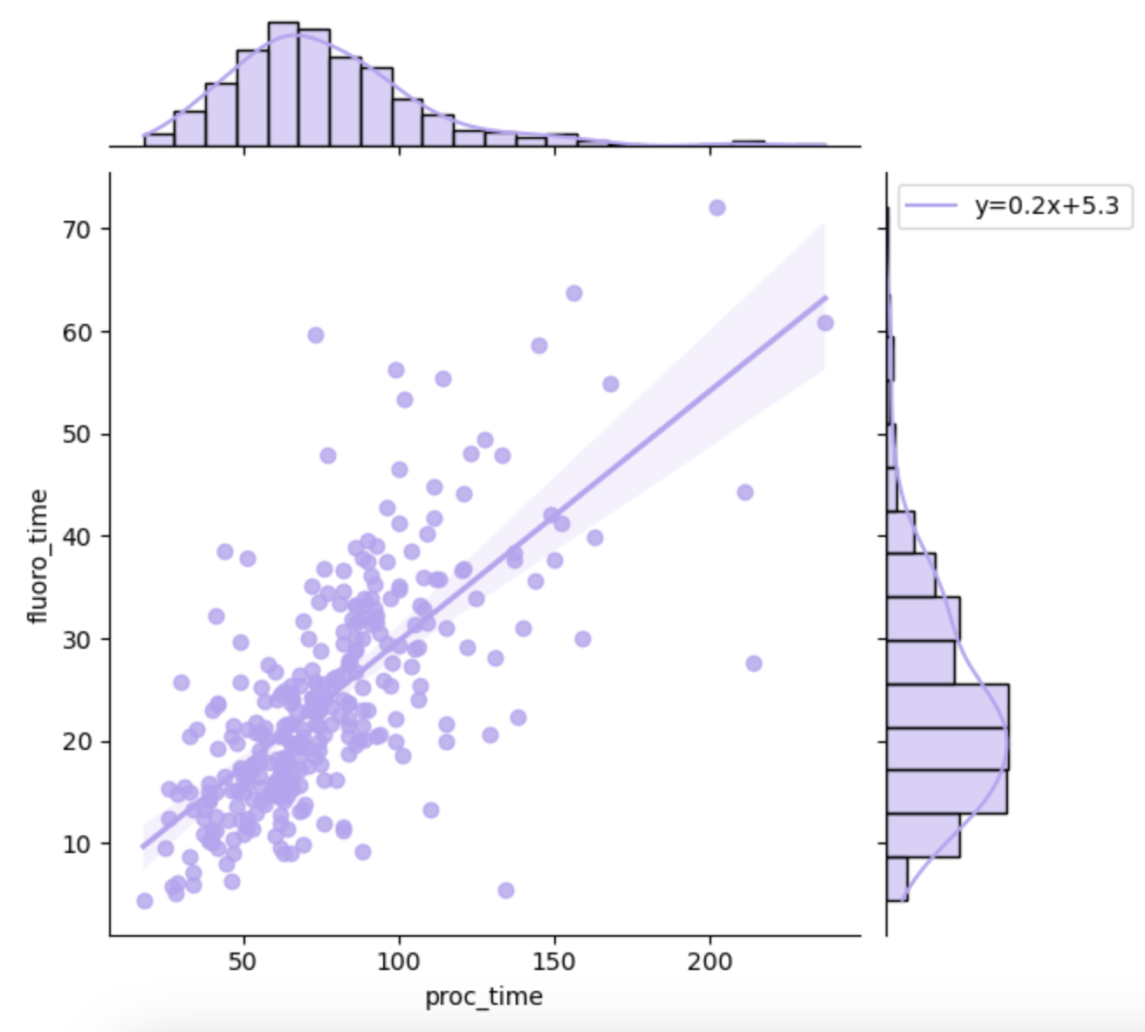
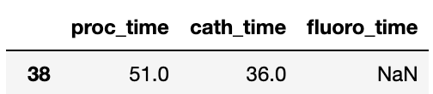
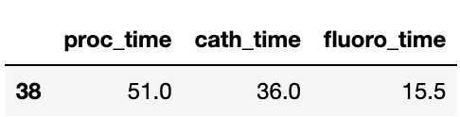
Missing Value — Fluoroscopy Time
Linear relationship between procedure time and fluoroscopy time
Use original procedure time to generate fluoroscopy time and fill null values

Slide 12
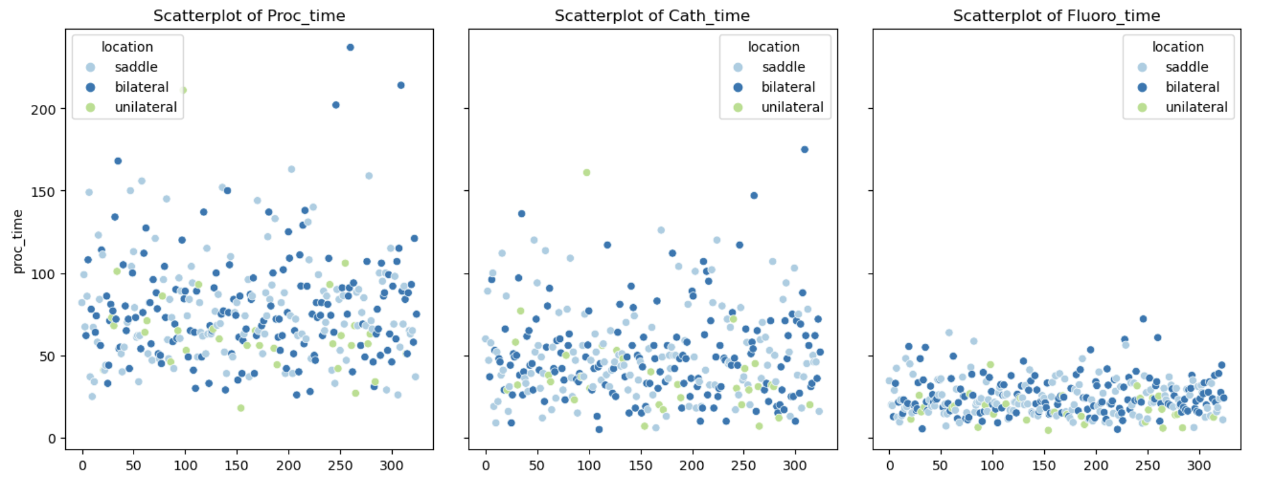
Location & Time Variables
Question: Is Pulmonary Embolism location making a difference in procedure time, catheter time, and fluoroscopy time?

Slide 13
Methodology — Kruskal-Wallis Test
A nonparametric method for testing whether 3 or more groups are originated from the same distribution
Null Hypothesis: The 3 locations are not different in terms of time variables distribution/median
Alternative Hypothesis: At least 1 location is different from the other 2 locations in terms of time variables distribution/median
Post-hoc pairwise test — the Dunn’s Test
Figure out the pairs of location having different distribution of time variables
Null hypothesis: there is no difference between groups
Alternate hypothesis: there is a difference between groups.

Slide 14
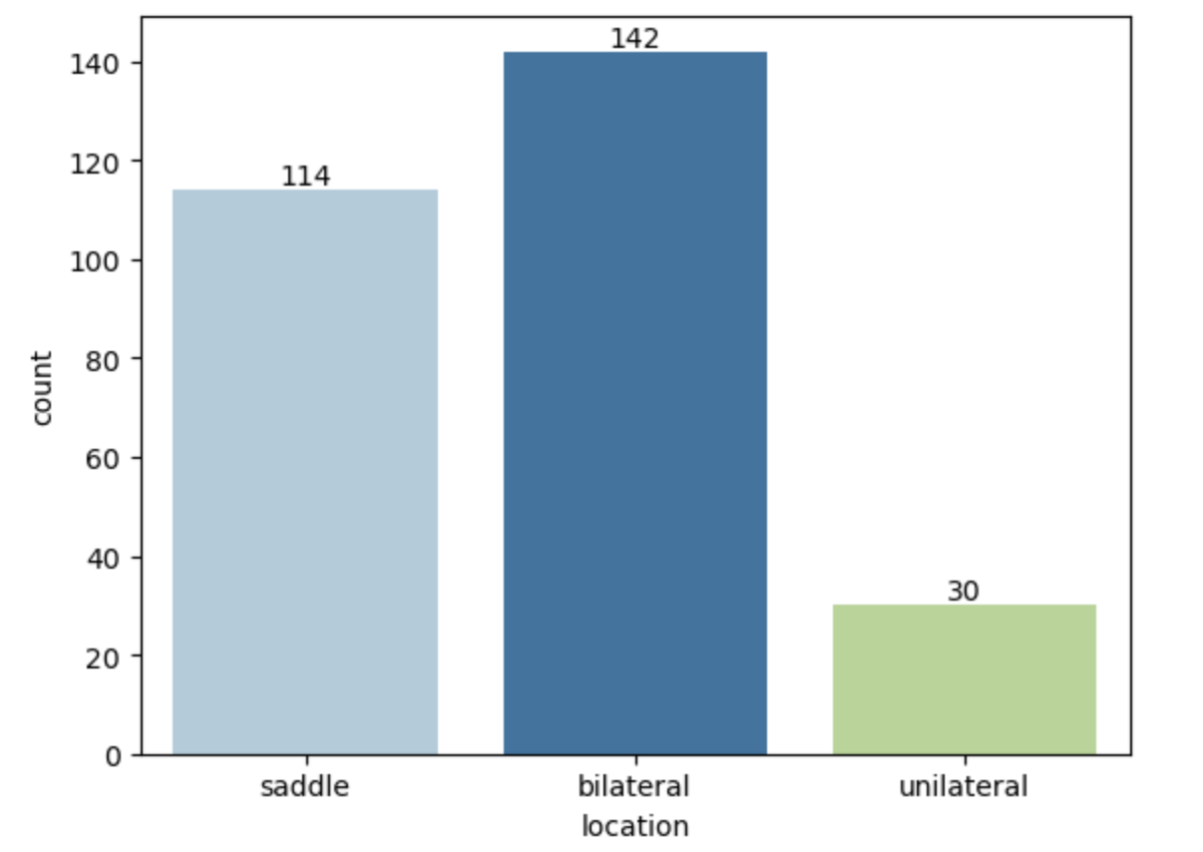
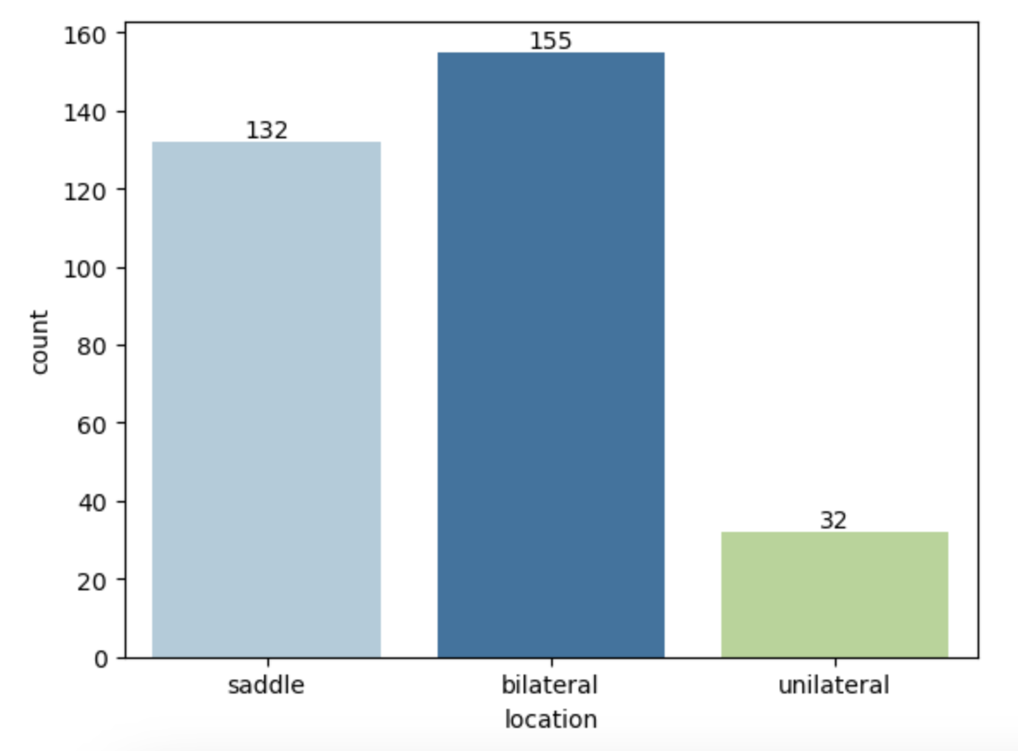
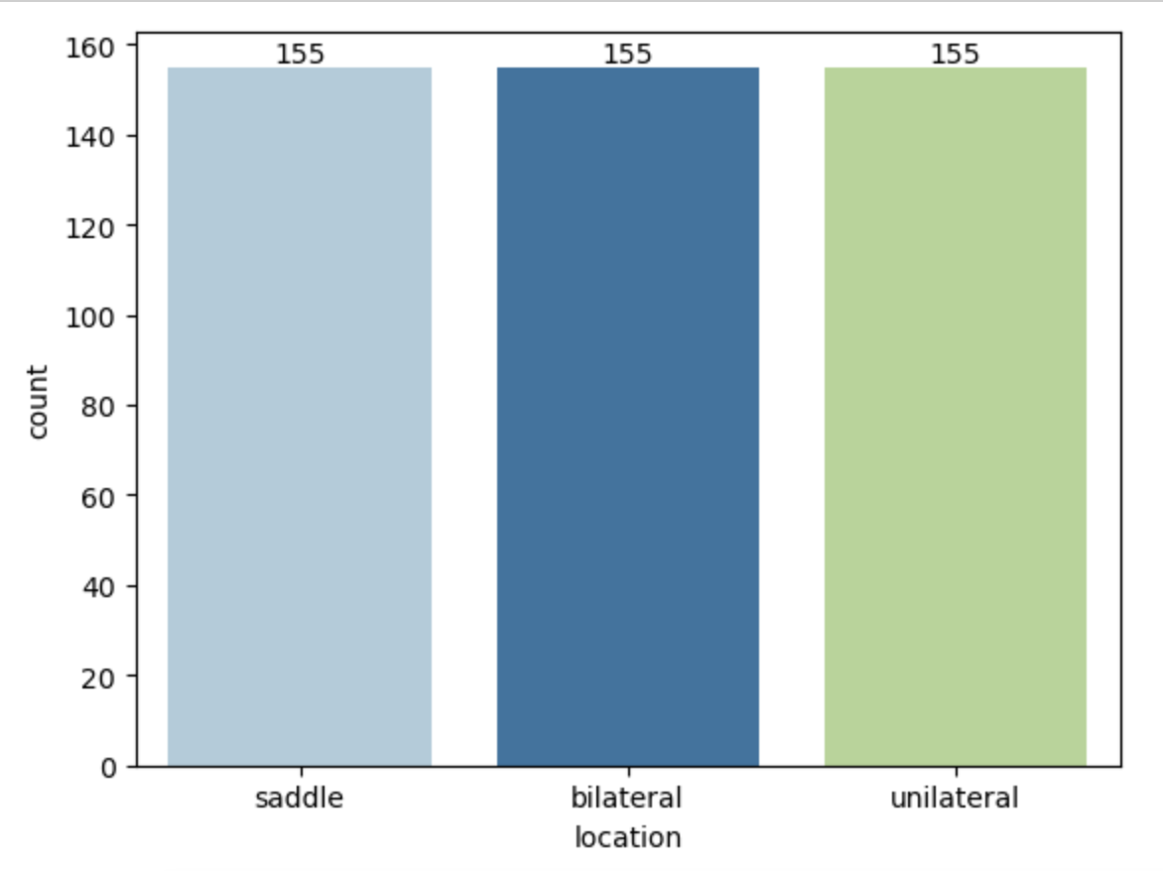
Methodology — Dataset Overview
Data Without Filling NA
Data After Filling NA
Data After Oversampling
286 Patients Data
319 Patients Data
465 Patients Data
Its atmosphere is very poisonous
It’s made of hydrogen & helium
It was named after a Roman god
It is the second planet from the Sun
It is the sixth planet from the Sun
It is the closest planet to the Sun

Slide 15
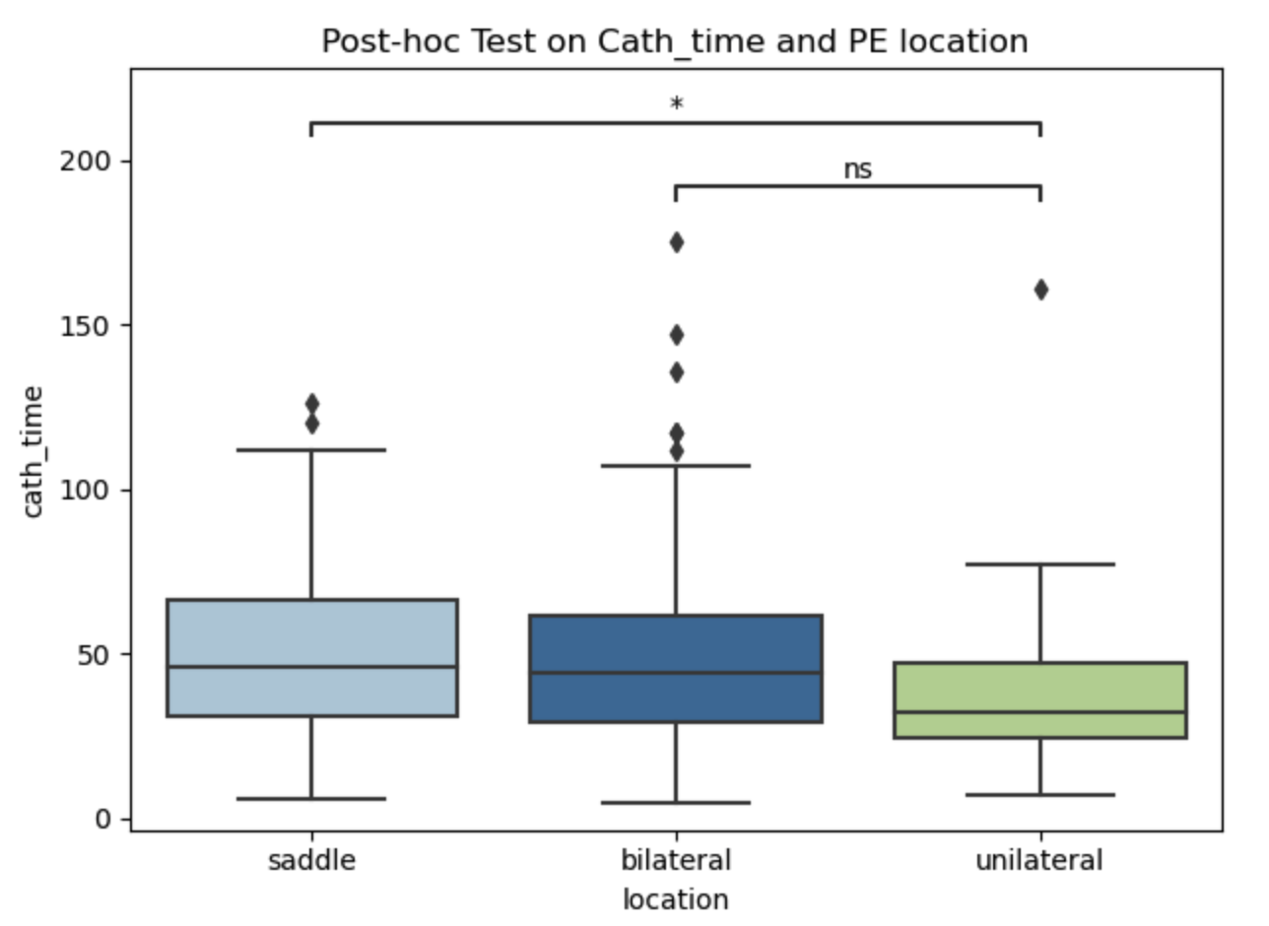
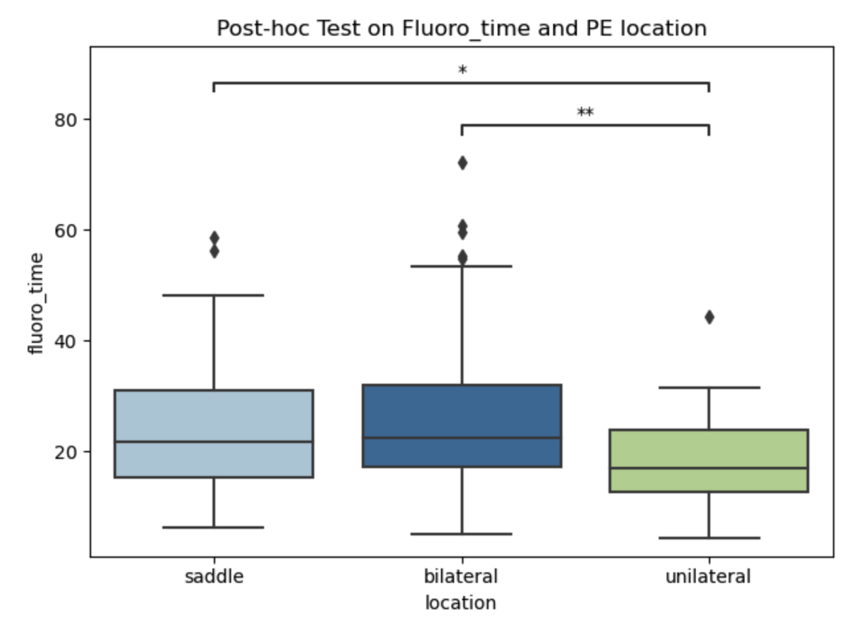
Test Result on Data Without Filling NA
There is a statistically significant difference between the medians of cath_time and fluoro_time in these 3 PE locations

Slide 16
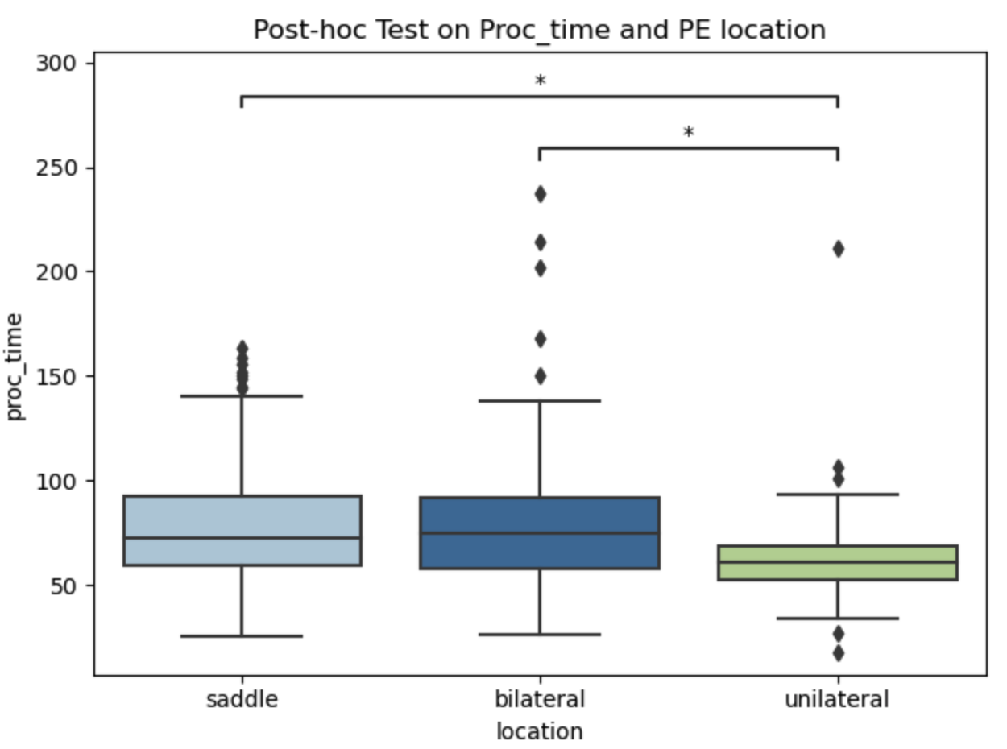
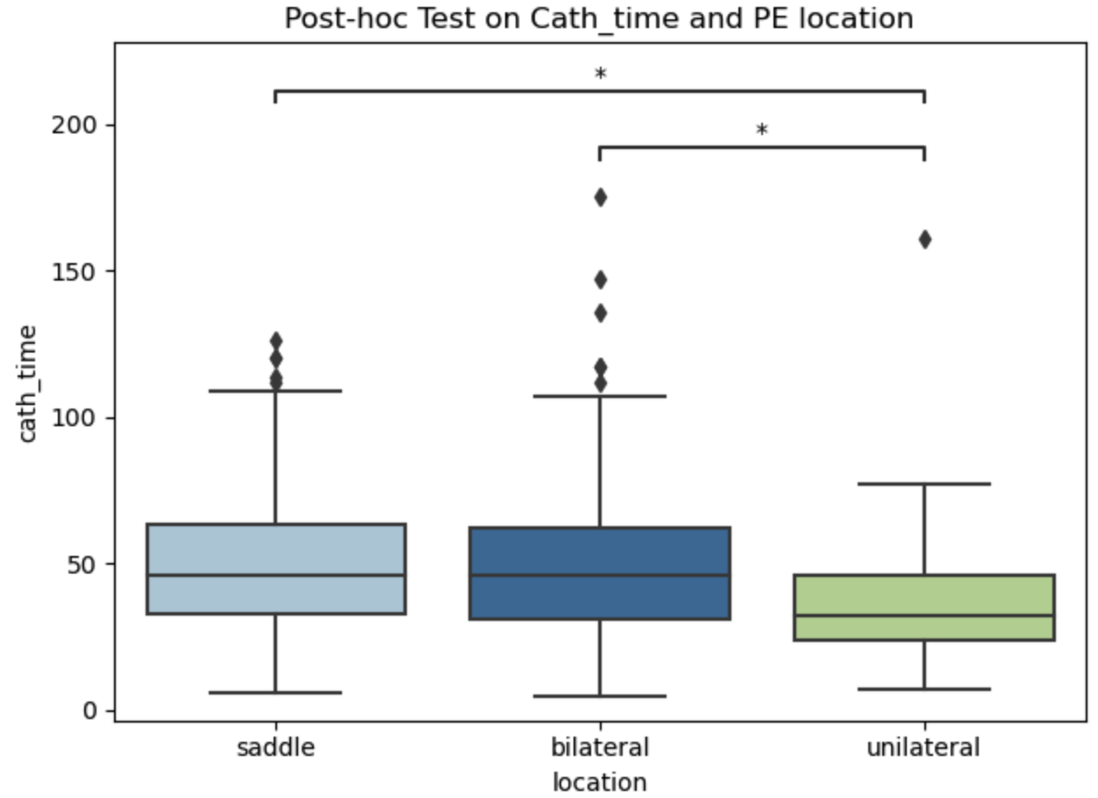
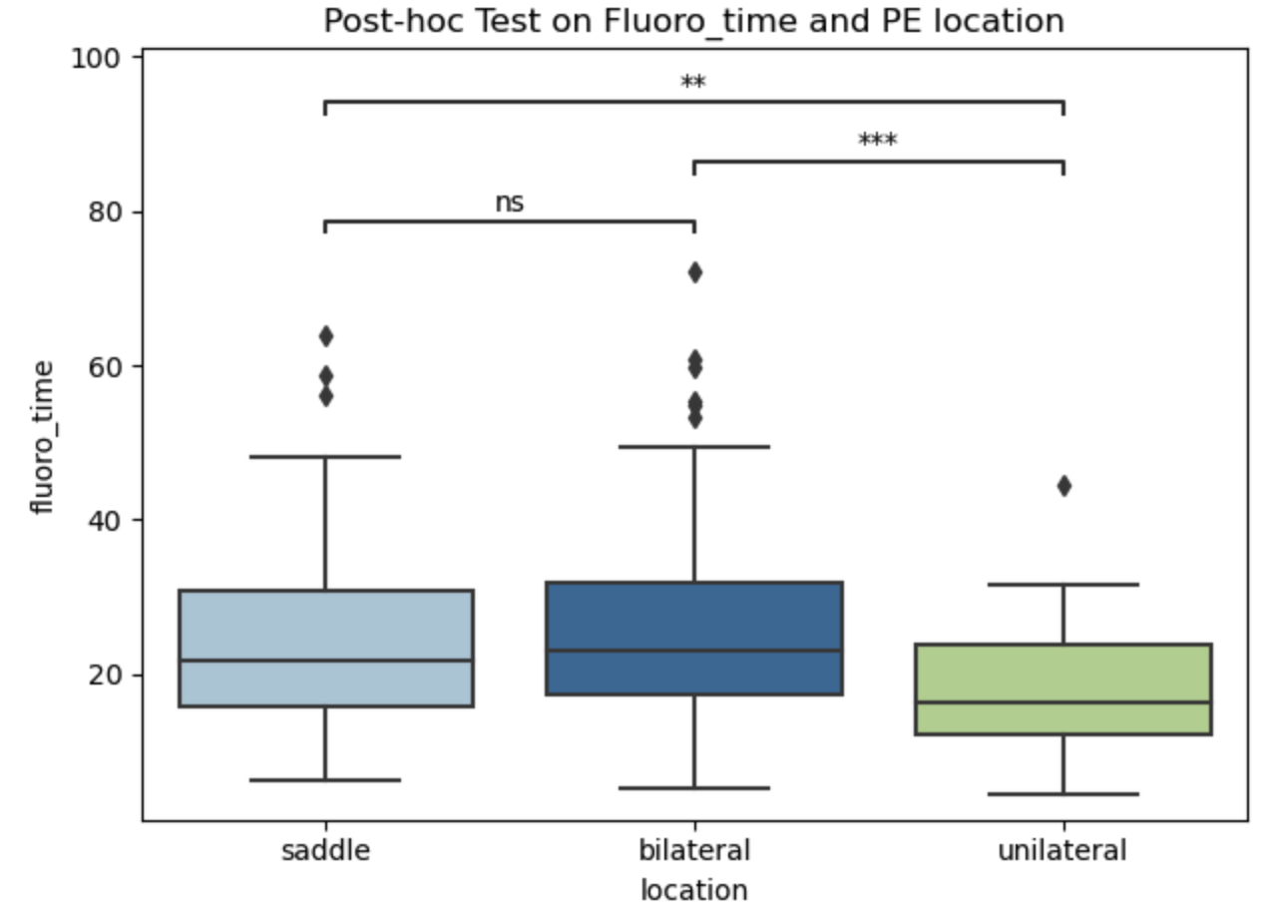
Test Result on Data After Filling NA
There is a statistically significant difference between the medians of proc_time, cath_time and fluoro_time in these 3 PE locations

Slide 17
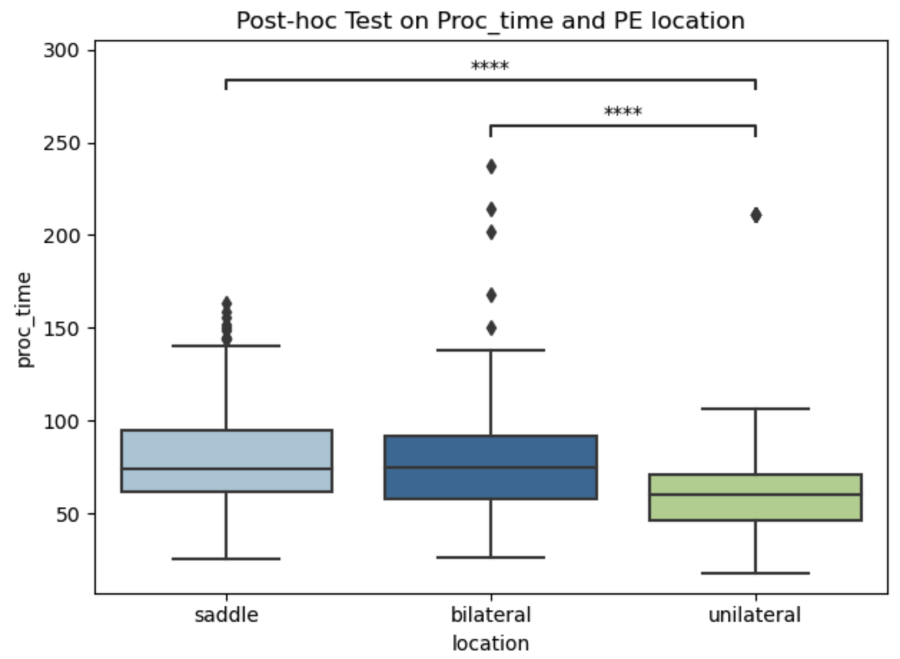
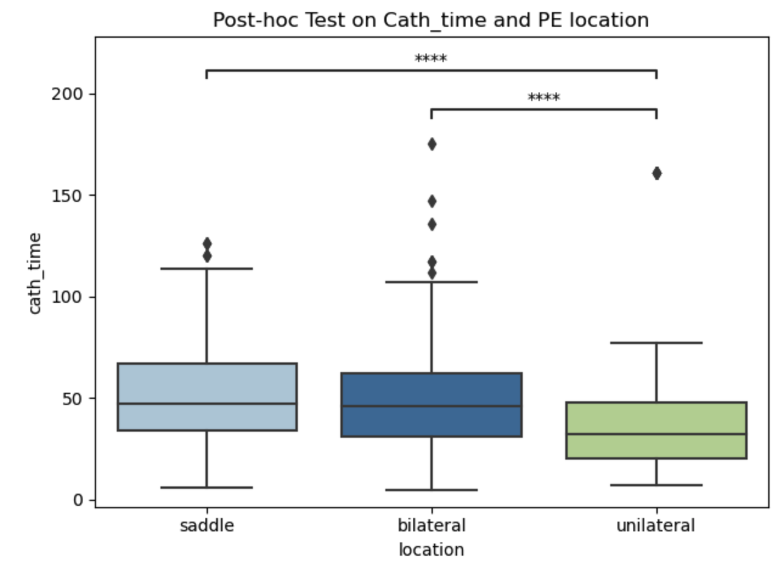
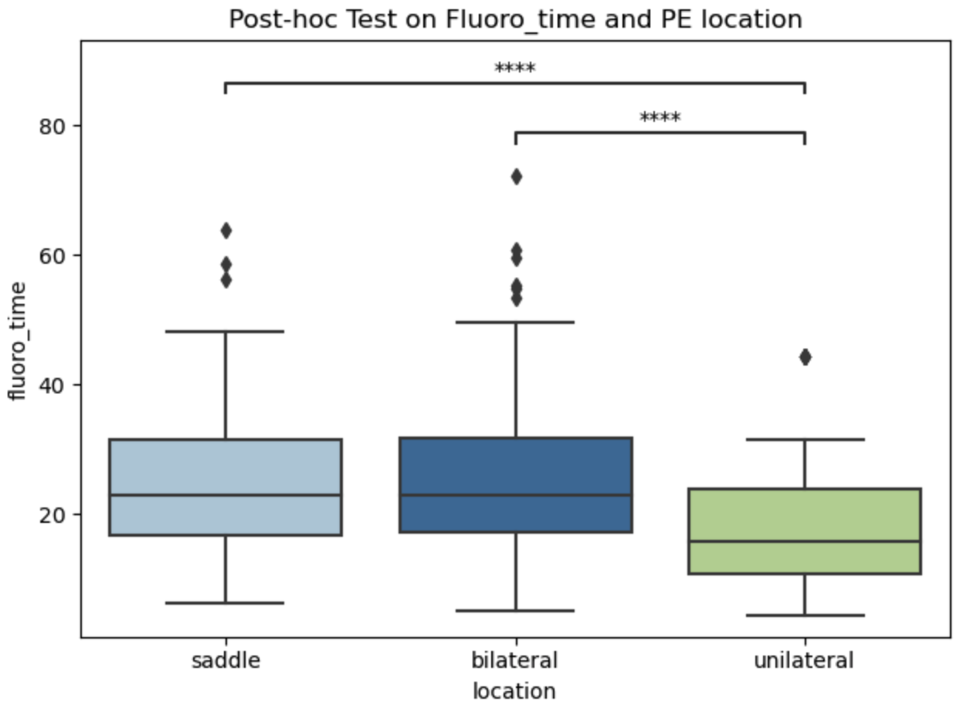
Test Result on Data After Oversampling
There is a statistically significant difference between the medians of proc_time, cath_time and fluoro_time in these 3 PE locations

Slide 18
Thank you for listening!

